Slide 1
AdaHack 2022 Presentation
By Pat, Fergus, Ali, Bobby and Ayush

Slide 2


Our Projects
HumanEd Rubik’s Cube: Beginner + Advanced
EUFS Bags Bonanza Challenge

Slide 3
1. HumanEd

Slide 4
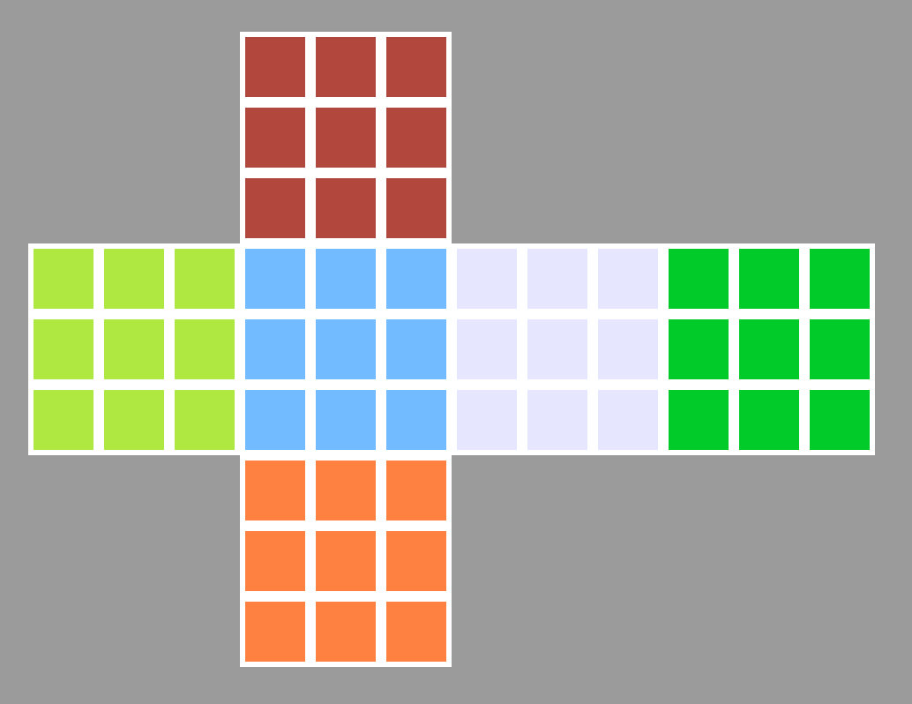
Beginner’s Challenge
We first studied the given code for the 2x2 matrix and extrapolated the values and created the 3x3 model
We then created a script to input a 54 letter string and split it up into 6 parts
We then converted each letter to its corresponding RGB value
Finally, we filled all the squares using the extrapolated versions of the given functions color_side, color_update and paint

Slide 5
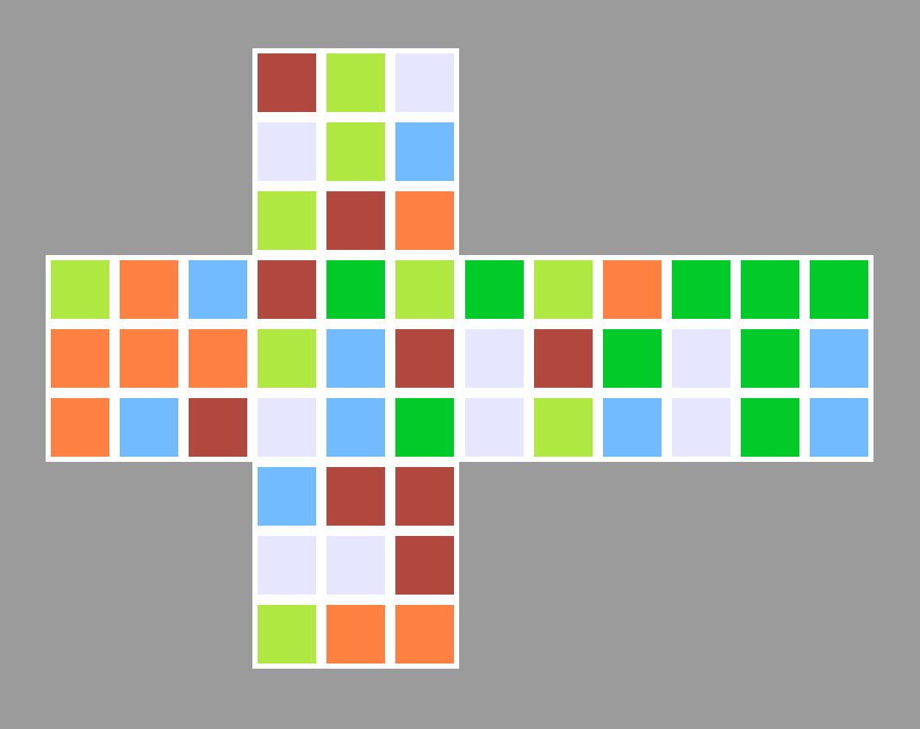
The Final Result
Example Input String: “rywwybyroyoboooobrrgyybrwbggyowrgwybgggwgbwgbbrrwwryoo”

Slide 6
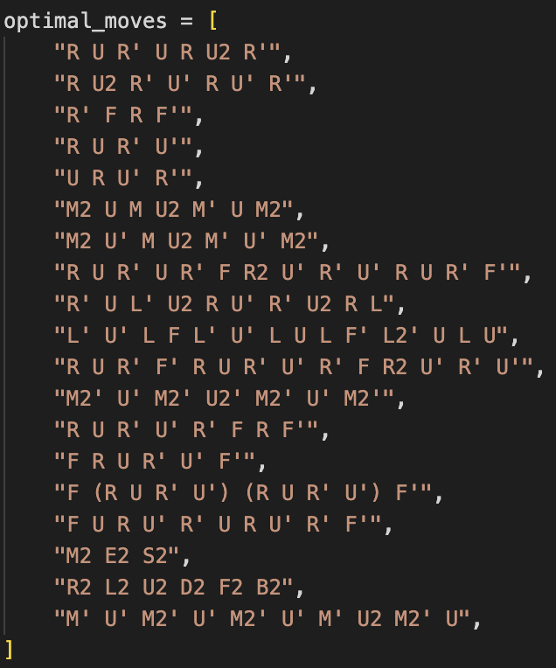
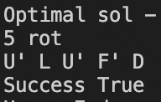
Advanced Challenge
Project progression
Reinforcement Learning attempt
Classic Cross Method
Brute Force
Brute Force
Common move combinations, that will always give a more optimal state
Recursion until cube has been solved
Applying the method
Rotating the cube after each operation
Mapping user input to solver’s format
Notes:
I first tried to tackle it using RL, however after I coded the model I quickly realised that it’d take too long to train and evaluate the model, with time quickly running out, I changed course and decided to move onto implementing the cross method, however it proved to be difficult and would take too long. So I shifted gears again and committed to a brute force recursive method, where I would recursively use a sequences of moves that prove to result in a more optimal state, two major issues I had to tackle was rotating the cube matrix after each operation, and mapping the user input to solving function. On the right is an example output from the solver, where it shows the moves requires to solve a randomly generated cube.

Slide 7
2. EUFS Bag Bonanza Challenge

Slide 8
The Project
We began with the idea of starting with a full stack development, including technologies such as the Flutter framework and Fast API.
We wanted a fast and simple GUI that allows the user to easily access the data as thats the primary reason for this website.
We knew the project had to run locally, with both the website and the files running on the same machine which helped with development, allowing us to do more with our time rather than setting the backend up the whole time.

Slide 9
The Front End
Here is where the pretty part of the build is:
Clear and simple GUI, with the main function of the page immediately there when you type the address into the browser
Simply type in the name of the file that you want to search and your searched for items will be brought on screen.
We focused on seamlessness, including things such as a responsive UI which scaled according to which window size the user has it in
Since we used Flutter, we have seamlessness between platforms too, as if it was truly necessary it could be accessed from a mobile quite easily.

Slide 10
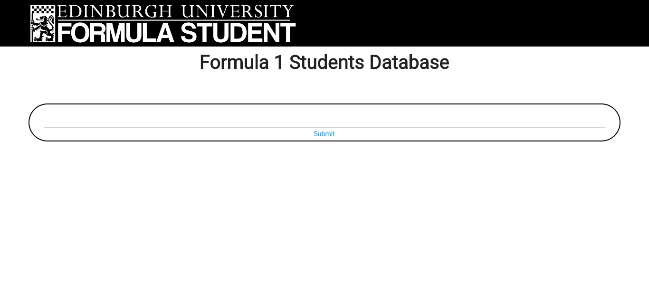
Examples

Slide 11
The backend
Fastapi as framework
Matplotlib
RESTful API (/getmap/{name})

Slide 12
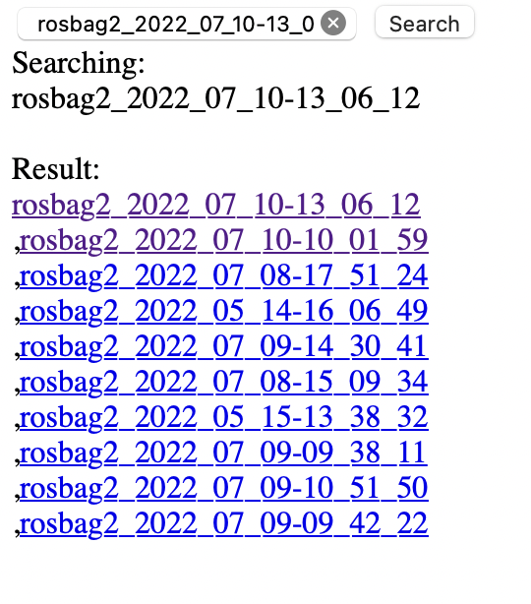
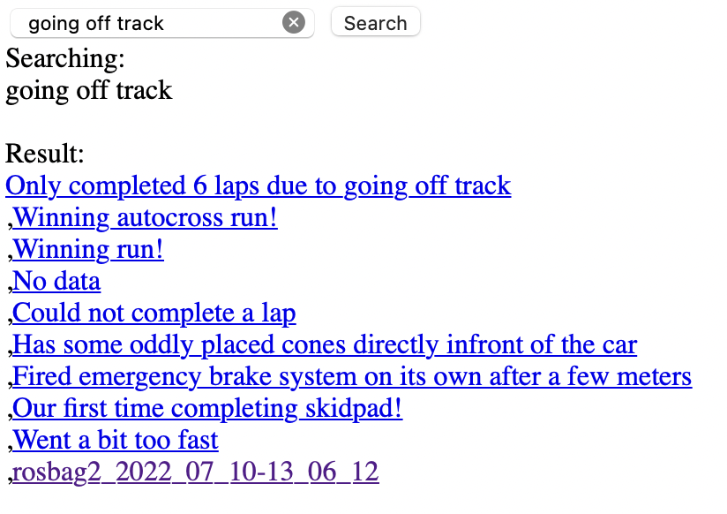
HTML SSR on Backend

Slide 13
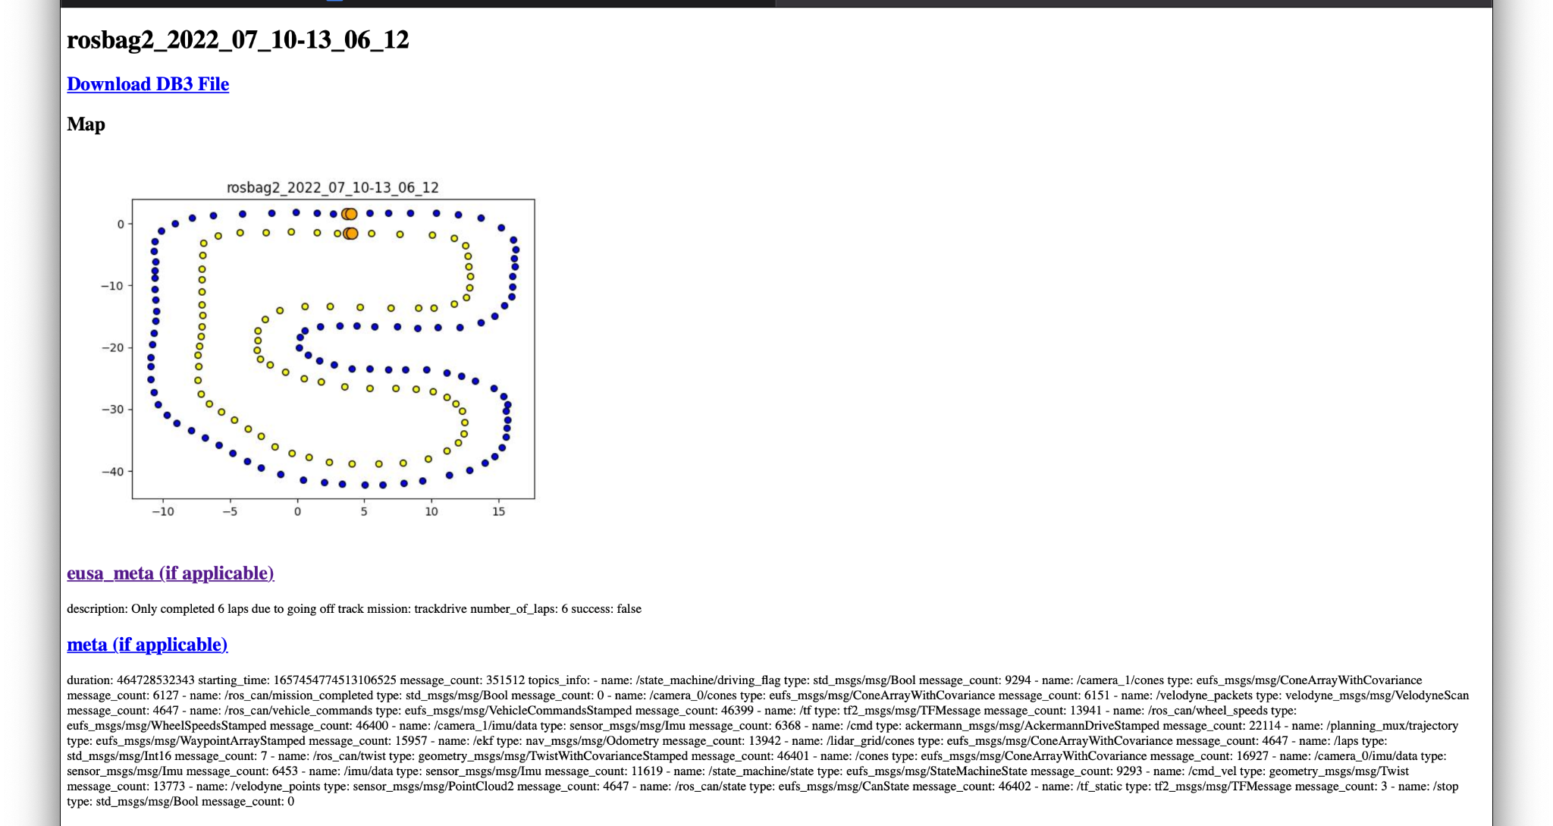
Another Example of SSR

Slide 14
What would we do better
If we could do it again, we would design a one page system, allowing everything to run on the one page, rather than having to load another page just for the results, leading to an under developed GUI for the results page

